Slide 1
Machine Learning : An Introduction
Dr. Noman Islam

Slide 2
Outline
Introduction to machine learning
Getting started with Scikit-learn
Machine learning concepts
Basic mathematics
Advanced concepts of machine learning
Deep dive into scikit-learn

Slide 3
Introduction
Deep learning is a speciﬁc kind of machine learning.
A machine learning algorithm is an algorithm that is able to learn from data.
A computer program is said to learn from experience E with respect to some class of tasks T and performance measure P , if its performance at tasks in T , as measured by P, improves with experience E

Slide 4
Task
Machine learning allows us to tackle tasks that are too diﬃcult to solve with ﬁxed programs written and designed by human beings.
Machine learning tasks are usually described in terms of how the machine learning system should process an example
An example is a collection of features that have been quantitatively measured from some object or event that we want the machine learning system to process.
The features of an image are usually the values of the pixels in the image

Slide 5
Common machine learning tasks
Classification: the learning algorithm is usually asked to produce a function f:R^{n}→ {1, . . . , k}. An example of a classiﬁcation task is object recognition, where the inputi s an image
Regression: In this type of task, the computer program is asked to predict a numerical value given some input. To solve this task, the learning algorithm is asked to output a function f :R^{n}→ R

Slide 6
Transcription: In this type of task, the machine learning system is asked to observe a relatively unstructured representation of some kind of data and transcribe it into discrete, textual form. For example, in optical character recognition, the computer program is shown a photograph containing an image of text and is asked to return this text in the form of a sequence of characters. Another example is speech recognition, where the computer programis provided an audio waveform and emits a sequence of characters or wordID codes describing the words that were spoken in the audio recording.

Slide 7
Machine Translation: In a machine translation task, the input already consists of a sequence of symbols in some language, and the computer program must convert this into a sequence of symbols in another language.
Anamoly Detection: In this type of task, the computer program sifts through a set of events or objects, and ﬂags some of them as being unusual or atypical. An example of an anomaly detection task is credit card fraud detection.

Slide 8
Synthesis and Sampling: In this type of task, the machine learning algorithm is asked to generate new examples that are similar to those in the training data. For example, video games can automatically generate textures for large objects or landscapes, rather than requiring an artist to manually label each pixel

Slide 9
Scikit-learn
Scikit-learn (Sklearn) is the most useful and robust library for machine learning in Python.
It provides a selection of efficient tools for machine learning and statistical modeling including classification, regression, clustering and dimensionality reduction via a consistence interface in Python.
This library, which is largely written in Python, is built upon NumPy, SciPy and Matplotlib.

Slide 10
Installation
pip install -U scikit-learn
conda install scikit-learn

Slide 11
Datasets
A collection of data is called dataset. It is having the following two components −
Features − The variables of data are called its features. They are also known as predictors, inputs or attributes.
Feature matrix − It is the collection of features, in case there are more than one.
Feature Names − It is the list of all the names of the features.

Slide 12
Response − It is the output variable that basically depends upon the feature variables. They are also known as target, label or output.
Response Vector − It is used to represent response column. Generally, we have just one response column.
Target Names − It represent the possible values taken by a response vector.
Scikit-learn have few example datasets like iris and digits for classification and the Boston house prices for regression.

Slide 13
Loading data in sk-learn
from sklearn.datasets import load_iris
iris = load_iris()
X = iris.data
y = iris.target
feature_names = iris.feature_names
target_names = iris.target_names
print("Feature names:", feature_names)
print("Target names:", target_names)
print("\nFirst 10 rows of X:\n", X[:10])

Slide 14
Splitting the data
from sklearn.model_selection import train_test_split
X_train, X_test, y_train, y_test = train_test_split(
X, y, test_size = 0.3, random_state = 1
)

Slide 15
Training a classifier
from sklearn.datasets import load_iris
iris = load_iris()
X = iris.data
y = iris.target
from sklearn.model_selection import train_test_split
X_train, X_test, y_train, y_test = train_test_split(
X, y, test_size = 0.4, random_state=1
)

Slide 16
from sklearn.neighbors import KNeighborsClassifier
from sklearn import metrics
classifier_knn = KNeighborsClassifier(n_neighbors = 3)
classifier_knn.fit(X_train, y_train)
y_pred = classifier_knn.predict(X_test)

Slide 17
# Finding accuracy by comparing actual response values(y_test)with predicted response value(y_pred)
print("Accuracy:", metrics.accuracy_score(y_test, y_pred))
# Providing sample data and the model will make prediction out of that data
sample = [[5, 5, 3, 2], [2, 4, 3, 5]]
preds = classifier_knn.predict(sample)
pred_species = [iris.target_names[p] for p in preds] print("Predictions:", pred_species)

Slide 18
Saving model
from sklearn.externals import joblib
joblib.dump(classifier_knn, 'iris_classifier_knn.joblib')
joblib.load('iris_classifier_knn.joblib')

Slide 19
Performance Measure
Accuracy is just the proportion of examples for which the model produces the correct output
Error rate , the proportion of examples for which the model produces an incorrect output
Test dataset
Overfitting
Underfitting

Slide 20
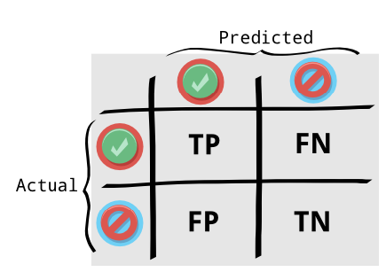

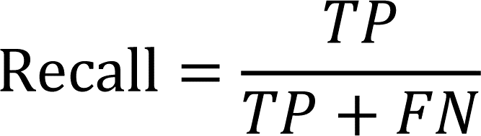
Precision and Recall

Slide 21
Experience
Supervised Learning
Unsupervised Learning
A dataset is a collection of many examples
One of the oldest datasets studied by statisticians and machine learning researchers is the Iris dataset

Slide 22
Unsupervised learning
Unsupervised learning algorithms experience a dataset containing many features, then learn useful properties of the structure of this dataset
Clustering

Slide 23
Supervised Learning
Supervised learning algorithms experience a dataset containing features, but each example is also associated with a label or target
A supervised learning algorithm can study the Iris dataset and learn to classify iris plants into three diﬀerent species based on their measurements

Slide 24
Roughly speaking, unsupervised learning involves observing several examples of a random vector x, and attempting to implicitly or explicitly learn the probability distribution p(x), or some interesting properties of that distribution
Unsupervised learning and supervised learning are not formally deﬁned terms.
Some machine learning algorithms do not just experience a ﬁxed dataset. For example, reinforcement learning algorithms interact with an environment, so there is a feedback loop between the learning system and its experiences

Slide 25
Sets
Natural numbers = {1, 2, 3, 4, …}
Whole numbers = {0,1,2,…}
Integers = {…,-2,-1,0,1,2,…}
Real Numbers
Even numbers = {…,-2,0,2,4, …}
Odd numbers = {…,-3,-1,1,3, …}
Prime numbers = {2,3,5,7,…}

Slide 26
Equation of line
y=mx+b
Plotting a line
Slope
y-intercept
Roots of an equation

Slide 27
Statistics
Mean
Median
Mode
Range

Slide 28


Variance
Standard deviation
Correlation

Slide 29
Functions
Composition
Maxima / Minima

Slide 30
Vectors
height_weight_age = [70,170, 40 ]
Adding two vectors
Subtracting two vectors
Scalar multiplication
Dot product
Magnitude
Distance

Slide 31
Matrices
Shape
Adding two matrix
Multiplying two matrix

Slide 32
Linear Regression
The goal is to build a system that can take a vector x ∈ R^{n} as input and predict the value of a scalar y ∈ R as its output
We deﬁne the output to be y = wx, where w ∈ R^{n} is a vector of parameters
We can think of w as a set of weights that determine how each feature aﬀects the prediction

Slide 33
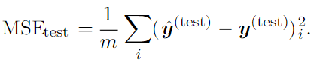
One way of measuring the performance of the model is to compute the mean squared error of the model on the test set.
If ˆy(test) gives the predictions of the model on the test set, then the mean squared error is given by

Slide 34
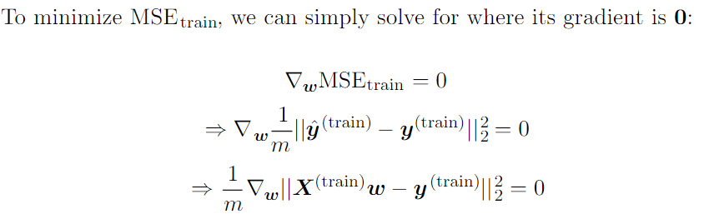

Slide 35
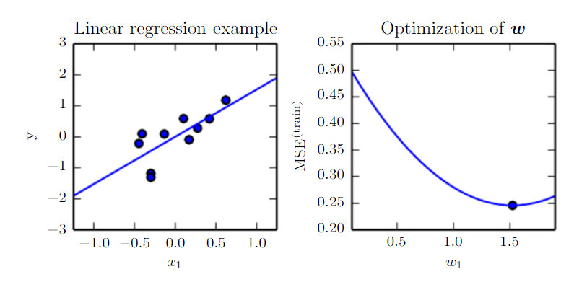

Slide 36
It is worth noting that the term linear regression is often used to refer to a slightly more sophisticated model with one additional parameter—an intercept term b. In this model
y = wx + b
The intercept term b is often called the bias parameter

Slide 37
Capacity, overfitting and underfitting
The ability to perform well on previously unobserved inputs is called generalization
Training error
What separates machine learning from optimization is that we want the generalization error , also called the test error , to be low as well.
The train and test data are generated by a probability distribution over datasets called the data generating process
We typically make a set of assumptions known collectively as the i.i.d. assumptions

Slide 38
The factors determining how well a machine learning algorithm will perform are its ability to:
1. Make the training error small.
2. Make the gap between training and test error small
These two factors correspond to the two central challenges in machine learning:
Underﬁtting
and overﬁtting
Underﬁtting occurs when the model is not able to obtain a suﬃciently low error value on the training set.
Overﬁtting occurs when the gap between the training error and test error is too large.

Slide 39
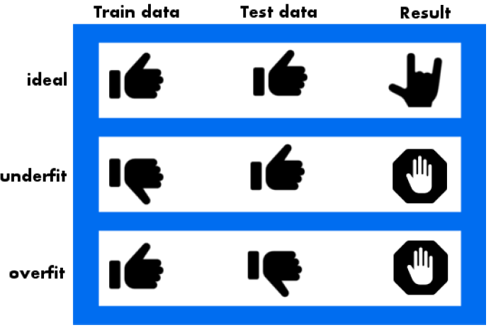

Slide 40
We can control whether a model is more likely to overﬁt or underﬁt by altering its capacity
Informally, a model’s capacity is its ability to ﬁt a wide variety of functions
Models with low capacity may struggle to ﬁt the training set.
Models with high capacity can overﬁt by memorizing properties of the training set that do not serve them well on the test set

Slide 41


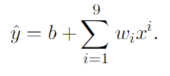
Hypothesis space
One way to control the capacity of a learning algorithm is by choosing its hypothesis space, the set of functions that the learning algorithm is allowed to select as being the solution

Slide 42
Machine learning algorithms will generally perform best when their capacity is appropriate for the true complexity of the task they need to perform and the amount of training data they are provided with.
Models with insuﬃcient capacity are unable to solve complex tasks.
Models with high capacity can solve complex tasks, but when their capacity is higher than needed to solve the present task they may overﬁt.

Slide 43
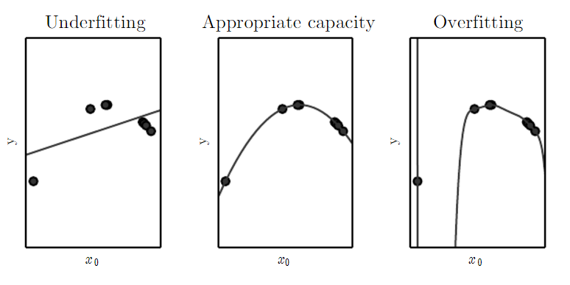

Slide 44
Nearest neighboor regression
When asked to classify a test point x , the model looks up the nearest entry in the training set and returns the associated regression target.

Slide 45
Hyper parameters
Most machine learning algorithms have several settings that we can use to control the behavior of the learning algorithm
The degree of the polynomial

Slide 46
Bias and Variance
Variance is how sensitive a prediction is to what training set was used. Ideally, how we choose the training set shouldn’t matter – meaning a lower variance is desired.
Bias is the strength of assumptions made about the training dataset. Making too many assumptions might make it hard to generalize, so we prefer low bias as well.
A too flexible model has high variance and low bias, whereas a too strict model has low variance and high bias.
Ideally we would like a model with both low variance error and low bias error. That way, it both generalizes to unseen data and captures the regularities of the data.

Slide 47
Consistency
Usually, we are also concerned with the behavior of an estimator as the amount of training data grows
In particular, we usually wish that, as the number of data points m in our dataset increases, our point estimates converge to the true value of the corresponding parameters

Slide 48
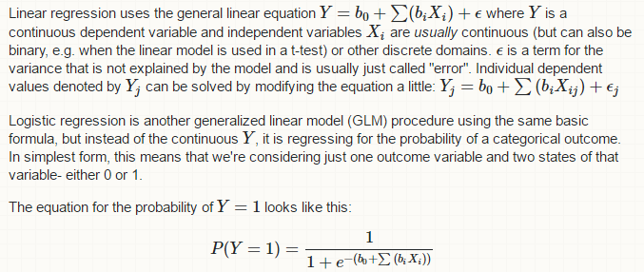
Logistic Regression

Slide 49
Support Vector Machine
In this algorithm, we plot each data item as a point in n-dimensional space (where n is number of features you have) with the value of each feature being the value of a particular coordinate. Then, we perform classification by finding the hyper-plane that differentiate the two classes very well

Slide 50
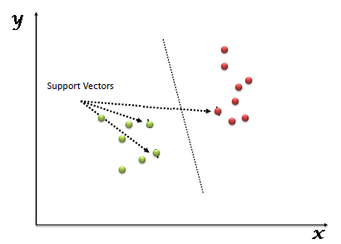

Slide 51
Decision Tree Classifier
Each node of the decision tree is associated with a region in the input space, and internal nodes break that region into one sub-region for each child of the node
Space is thus sub-divided into non-overlapping regions, with a one-to-one correspondence between leaf nodes and input regions. Each leaf node usually maps every point in its input region to the same output

Slide 52
Unsupervised Learning Algorithm
A classic unsupervised learning task is to ﬁnd the “best” representation of the data.
We are looking for a representation that preserves as much information about x as possible while obeying some penalty or constraint aimed at keeping the representation simpler or more accessible than x itself
Low-dimensional representations attempt to compress as much information about x as possible in a smaller representation

Slide 53
Principal Component Analysis
A representation that has lower dimensionality than the original input.
It also learns a representation whose elements have no linear correlation with each other
This transformation is defined in such a way that the first principal component has the largest possible variance (that is, accounts for as much of the variability in the data as possible), and each succeeding component in turn has the highest variance possible under the constraint that it is orthogonal to the preceding components.

Slide 54
K-means clustering
The k-means clustering algorithm divides the training set into k diﬀerent clusters of examples that are near each other.
Thek-means algorithm works by initializing k diﬀerent centroids{µ(1), . . . , µ(k)}to diﬀerent values, then alternating between two diﬀerent steps until convergence.In one step, each training example is assigned to cluster i, where i is the index ofthe nearest centroidµ(i).
In the other step, each centroidµ(i)is updated to themean of all training examples x(j)assigned to cluster I

Slide 55
Stochastic Gradient Descent
Nearly all of deep learning is powered by one very important algorithm: stochastic gradient descent or SGD
The cost function used by a machine learning algorithm often decomposes as a sum over training examples of some per-example loss function
It is the main way to train large linear models on very large datasets.

Slide 56
Building a machine learning algorithm
Nearly all deep learning algorithms can be described as particular instances of a fairly simple recipe:
combine a speciﬁcation of a dataset,
a cost function,
An optimization procedure
and a model.

Slide 57
Challenges that motivate deep learning
The simple machine learning algorithms described in this lecture work very well on a wide variety of important problems.
However, they have not succeeded in solving the central problems in AI, such as recognizing speech or recognizing objects.
The challenge of generalizing to new examples becomes exponentially more diﬃcult when working with high-dimensional data
The mechanisms used to achieve generalization in traditional machine learning are insuﬃcient to learn complicated functions in high-dimensional spaces.

Slide 58
Curse of Dimensionality
Many machine learning problems become exceedingly diﬃcult when the number of dimensions in the data is high.

Slide 59
Preprocessing data using scikit-learn
import numpy as np
from sklearn import preprocessing
Input_data = np.array(
[
[2.1, -1.9, 5.5],
[-1.5, 2.4, 3.5],
[0.5, -7.9, 5.6],
[5.9, 2.3, -5.8]
]
)
data_scaler_minmax = preprocessing.MinMaxScaler(feature_range=(0,1))
data_scaled_minmax = data_scaler_minmax.fit_transform(input_data)
print ("\nMin max scaled data:\n", data_scaled_minmax)

Slide 60
Estimator API
It is one of the main APIs implemented by Scikit-learn.
It provides a consistent interface for a wide range of ML applications that’s why all machine learning algorithms in Scikit-Learn are implemented via Estimator API.
The object that learns from the data (fitting the data) is an estimator.
It can be used with any of the algorithms like classification, regression, clustering or even with a transformer, that extracts useful features from raw data.
estimator.fit(data)

Slide 61
SVM
import numpy as np
from sklearn.datasets import load_iris
from sklearn.svm import SVC
X, y = load_iris(return_X_y = True)
clf = SVC()
clf.set_params(kernel = 'linear').fit(X, y)
clf.predict(X[:5])
clf.set_params(kernel = 'rbf', gamma = 'scale').fit(X, y)
clf.predict(X[:5])

Slide 62
Decision trees
from sklearn import tree
from sklearn.model_selection import train_test_split
X=[[165,19],[175,32],[136,35],[174,65],[141,28],[176,15]
,[131,32],[166,6],[128,32],[179,10],[136,34],[186,2],[12
6,25],[176,28],[112,38],[169,9],[171,36],[116,25],[196,2
5], [196,38], [126,40], [197,20], [150,25], [140,32],[136,35]]
Y=['Man','Woman','Woman','Man','Woman','Man','Woman','Ma
n','Woman','Man','Woman','Man','Woman','Woman','Woman','
Man','Woman','Woman','Man', 'Woman', 'Woman', 'Man', 'Man', 'Woman', 'Woman']
data_feature_names = ['height','length of hair']
X_train, X_test, y_train, y_test = train_test_split(X, Y, test_size = 0.3, random_state = 1)
DTclf = tree.DecisionTreeClassifier()
DTclf = clf.fit(X,Y)
prediction = DTclf.predict([[135,29]])
print(prediction)

Slide 63
Decision trees
%matplotlib inline
import matplotlib.pyplot as plt
import seaborn as sns; sns.set()
import numpy as np
from sklearn.cluster import KMeans
from sklearn.datasets import load_digits
digits = load_digits()
digits.data.shape
kmeans = KMeans(n_clusters = 10, random_state = 0)
clusters = kmeans.fit_predict(digits.data)
kmeans.cluster_centers_.shape

